Slide 1
Safe Sanitation Discrepancy Around the World
Jennifer Rutledge

Slide 2
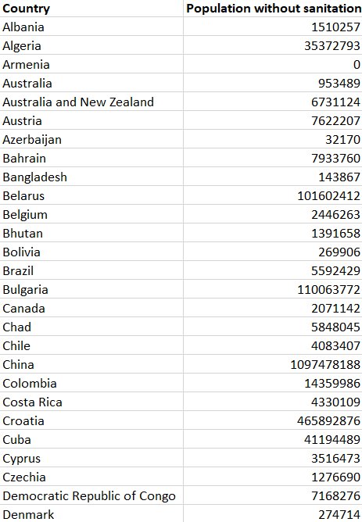
Visualization of the data

Slide 3
Almost half of the world’s population does not have access to safe sanitation
The poorest communities are the most affected by unsafe sanitation
Lack of access to these facilities, cause infectious diseases to thrive
According to the Global Burden of Disease study 775,000 people died prematurely in 2017 as a result of poor sanitation. To put this into context: this was almost double the number of homicides – close to 400,000 in 2017

Slide 4
Population without safe sanitation facilities

Slide 5
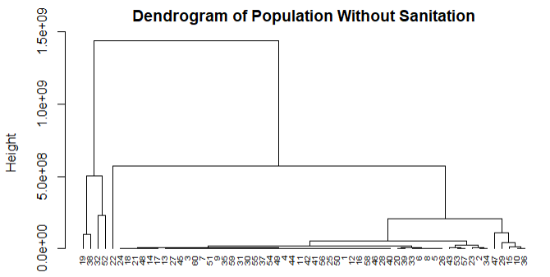
The Approach
Using the hierarchical Clustering method, we can determine which countries have the largest disparity and which have the smallest
By using the Dendrogram, our company can narrow down which countries would be the best to invest in

Slide 6
Investing in low-income communities and rural areas
By selecting which group of countries to invest in, our company will be able to provide a foundation in the underdeveloped communities.
Through establishing this foundation, we can gain support from the community which in turn will help with a better economy, access to clean water and sanitation, and a healthier population.
As shown in the graph and in the Dendrogram, we can see that rural areas in India, Africa, and Asia area have the lowest income.

